Slide 1

Galgotia’s College of Engineering and Technology
Project : Covid19 Updater & Predictor

Slide 2
Covid19 Updater & Predictor
Project of
Galgotias College of Engineering and Technology
IT department - B.tech Lateral
(Supervisor: Mr.Javed Sir )
Presented by
Ved Prakash Gupta (20GCEBIT023)
Utkarsh (20GCEBIT084)

Slide 3
What we do ?
CoronaUpdate is non-profit tool that gives the Update of COVID19 in India
and its States.
and also predicts the next 15 days COVID19 Situation in India. .
We send daily Update of COVID19 situation to Clients Mail .
In the form of Plots and Bars. For easily Understand and Seeing .
Technical Aspects :
it uses simple Machine learning and Data Science Algorithm for
Analysing , Processing and Predicting Data .

Slide 4

A General Introduction to COVID-19 A novel coronavirus (CoV) named ‘2019-nCoV’ or ‘2019 novel coronavirus’ or ‘COVID-19’ by the
World Health Organization (WHO) is in charge of the current outbreak of pneumonia that began at the beginning of December 2019 near in Wuhan City, Hubei Province, China [1–4]. COVID-19
is a pathogenic virus. From the phylogenetic analysis carried out with obtainable full genome sequences, bats occur to be the COVID-19 virus reservoir, but the intermediate host(s) has not been detected till now Coronaviruses are a large family of viruses that are known to cause illness ranging from the common cold to more severe diseases such as Middle East Respiratory Syndrome (MERS) and Severe Acute Respiratory Syndrome (SARS).

Slide 5
Table of Contents
01
02
03
04
05
06
About the Project
Requirements
Front View
CoronaUpdate
let’s talk about Backand
Website view
Software Infrastructure
Diagram
Our Team
Structure
Describe the topic
Parts

Slide 6
About the Project
01
Corona Update App
Tool is Designed & Developed for Predicting & Sending
Covid19 details to our Clients Mail in the Better way.
Who is our Client ?
Person who has been Successfully registered with CoronaUpdate tool.
Once You have registered with App . You will receive Covid19 details Everyday on Your Mail.

Slide 7
Requirements
02
: let’s talk about Backand
Web Framework : Python-flask
Database : Cloudant
Language :
Python
JavaScript
HTML
CSS
Data Science & Machine Learning tools :
Numpy
Pandas
Matplotlib
Fbprophet

Slide 8
Requirements
02
: Python Modules
pip==20.3.3
statsmodels
cloudant==2.14.0
Flask==1.1.2
google-api-core==1.24.1
google-api-python-client==1.12.8
google-auth==1.24.0
google-auth-httplib2==0.0.4
google-auth-oauthlib==0.4.2
googleapis-common-protos==1.52.0
httplib2==0.18.1
matplotlib==3.3.3
numpy==1.19.4
oauthlib==3.1.0
pandas==1.1.5
Pillow==8.0.1
prettytable==2.0.0
protobuf==3.14.0
pyasn1==0.4.8
pystan==2.19.1.1
pyasn1-modules==0.2.8
pyparsing==2.4.7
python-dateutil==2.8.1
pytz==2020.4
requests==2.25.1
requests-oauthlib==1.3.0
soupsieve==2.1
sqlparse==0.4.1
uritemplate==3.0.1
urllib3==1.26.2
Fbprophet

Slide 9

Python
Python is an Interpreted , high level and general-purpose programming language.
Python’s design philosophy emphasizes code
readability with its notable use of significant whitespace. Its language constructs and object-oriented approach aim to help programmers write clear,
logical code for small and large-scale projects.

Slide 10

Flask is a web development framework developed in Python. It is easy to learn and use. Flask is “beginner-friendly” because it does not have boilerplate code or dependencies, which can distract from the primary function of an application.
Features of Flask
Some features which make Flask an ideal framework for web application development are:
Flask provides a development server and a debugger.
It uses Jinja2 templates.
It is compliant with WSGI 1.0.
It provides integrated support for unit testing.
Many extensions are available for Flask, which can be used to enhance its functionalities.

Slide 11

HTML
Hypertext Markup Language is the standard markup language for documents designed to be displayed in a web browser.
It can be assisted by technologies such as Cascading
Style Sheets and scripting languages such as JavaScript.
HTML, as a markup language doesn’t really “do” anything in the sense that a programming language does. HTML contains no programming logic.
It doesn’t have common conditional statements such as If/Else. …
This is because HTML is not a programming language.

Slide 12

CSS
Cascading Style Sheets (CSS) is a style sheet language used for describing the presentation of a document written in a markup language such as HTML.[1] CSS is a cornerstone technology of the World Wide Web, alongside HTML and JavaScript.
CSS is designed to enable the separation of presentation and content, including layout, colors, and fonts.[3] This separation can improve content accessibility,
provide more flexibility and control in the specification of presentation characteristics, enable multiple web pages to share formatting by specifying the relevant CSS in a separate .css file which reduces complexity
and repetition in the structural content as well as enabling the .css file to be cached to improve the page load speed between the pages that share the file and its formatting.

Slide 13

JavaScript
JavaScript, often abbreviated as JS, is a programming language that conforms to the ECMAScript specification. JavaScript is high-level, often just-in-time compiled, and multi-paradigm. It has curly-bracket syntax, dynamic typing, prototype-based object-orientation, and first-class functions. As a multi-paradigm language, JavaScript supports event-driven, functional, and imperative programming styles. It has application programming interfaces (APIs) for working with text, dates, regular expressions, standard data structures, and the Document Object Model (DOM). However, the language itself does not include any input/output (I/O), such as networking, storage, or graphics facilities, as the host environment (usually a web browser) provides those APIs.

Slide 14

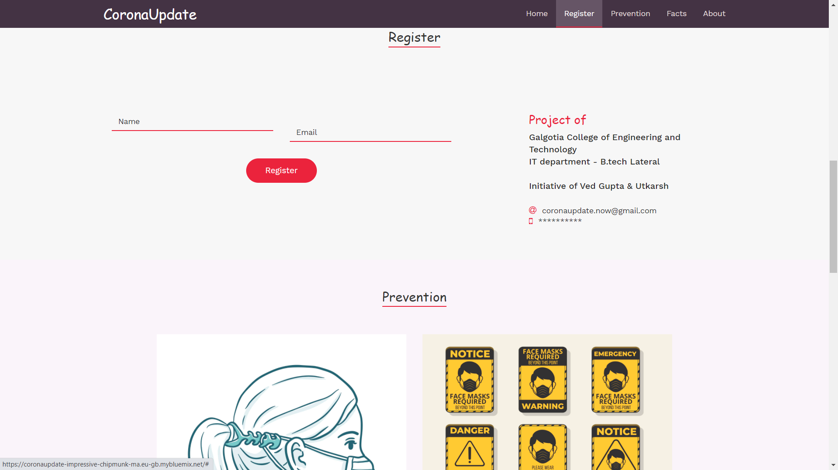
CoronaUpdate
Let’s see how’s the App looks like
: Front View

Slide 15
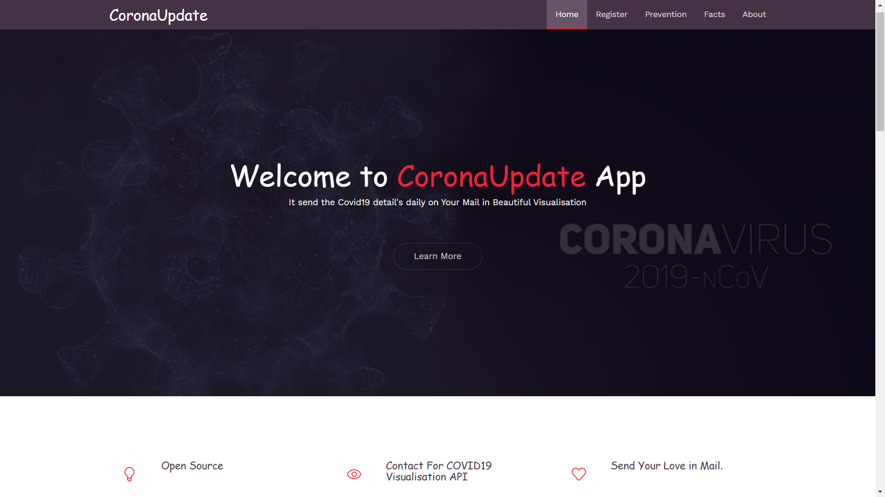
03

Slide 16
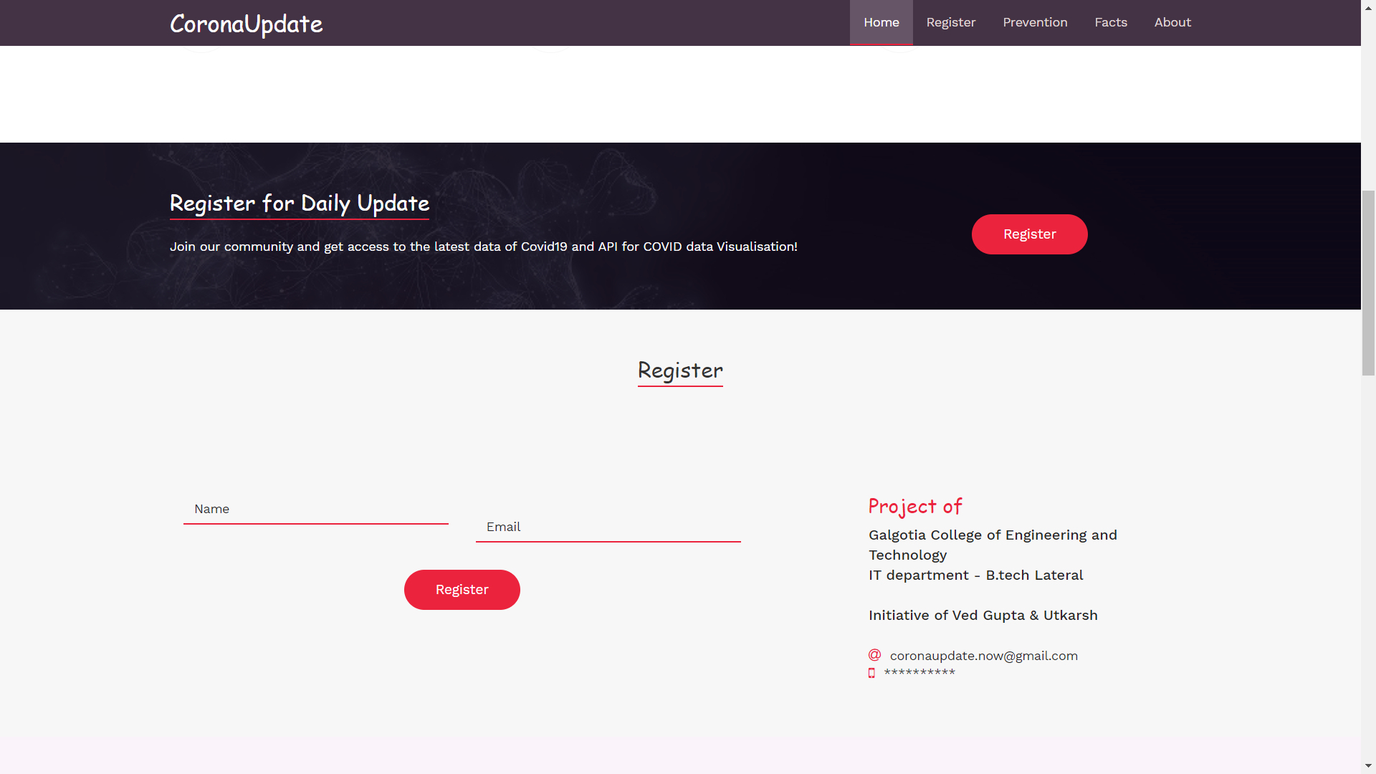

Slide 17
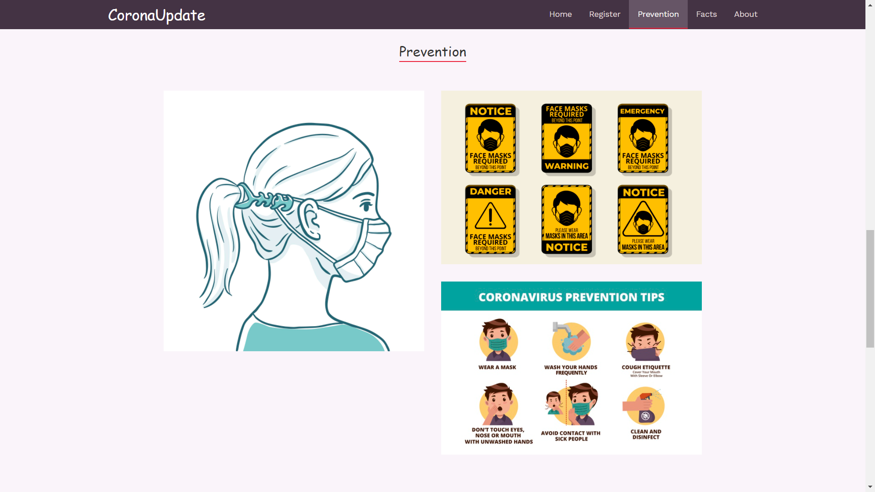

Slide 18
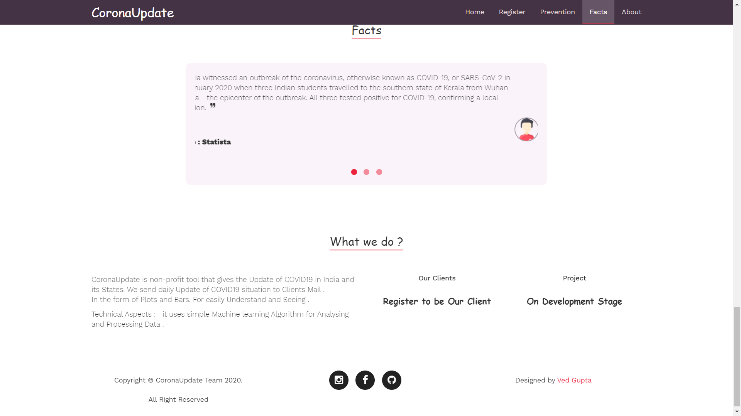
nextin.ml

Slide 19
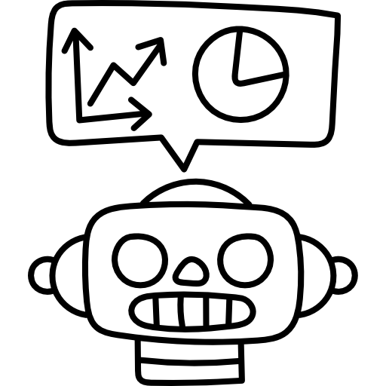
04
Let we see the software infrastructure :
Email Connection
Data
Predicting
Create an Email Connection for Sending Emails
Receive Data from different sources .
Process & Analyze it .
And make it useful.
Predict the next 15 days Covid Cases
Using : fbprophet

Slide 20
Data Visualisation
web
Database
Make plots & Bar Using Data.
For better Understanding
Create a Web app Using Python-flask
( Static Website )
Database to store Name & Email
Cloudant Database

Slide 21
Google Analytics
Result 1
Real time Traffic
& Custom Reports
Result 2
Audience Details On Your Site
Result 3
Google Analytics is one of the most popular digital analytics software. It is Google's free web analytics service that allows you to analyze in-depth detail about the visitors on your website. It provides valuable insights that can help you to shape the success strategy of your business.
Device Category,Browser , Os & other Details

Slide 22
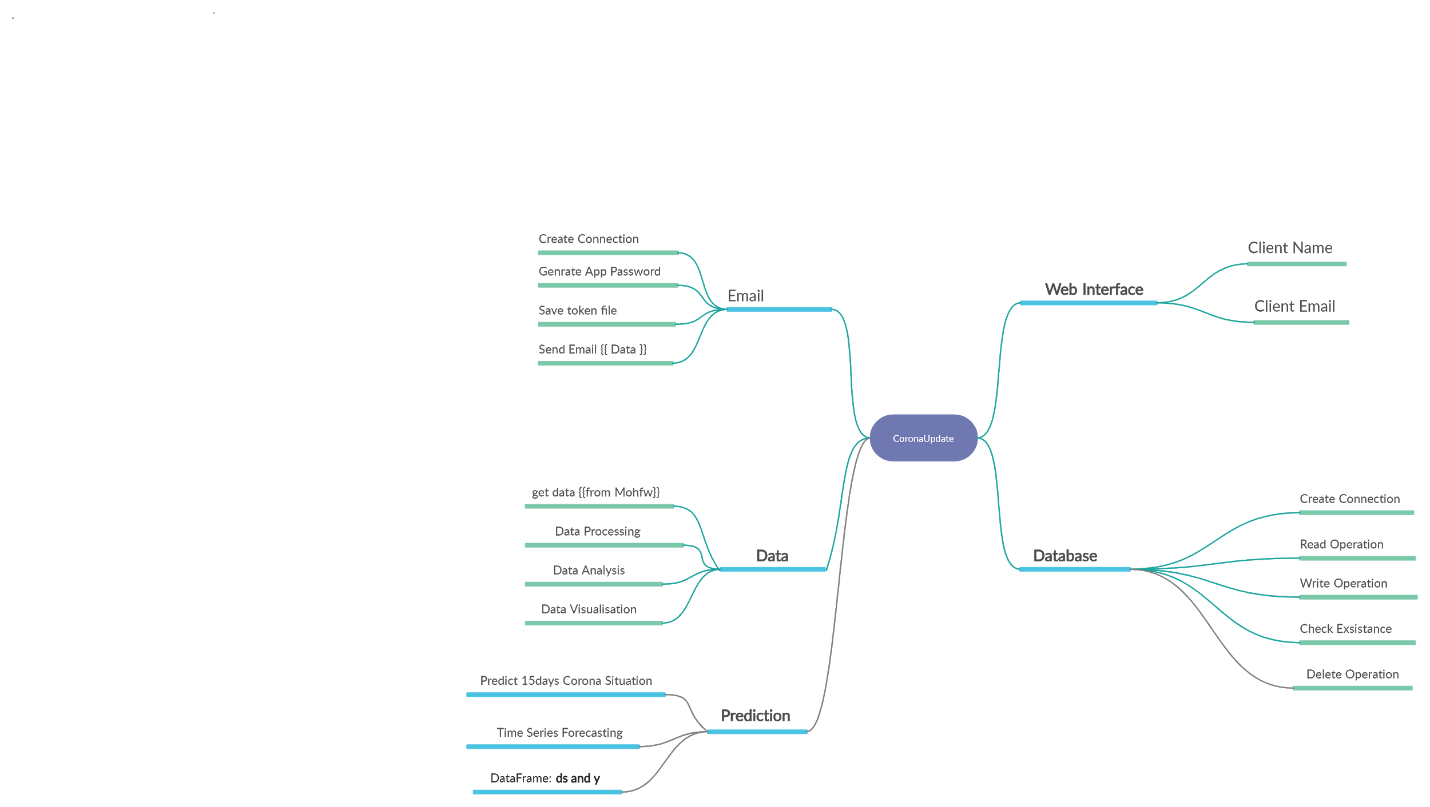
ER Diagram

Slide 23
Data Flow Diagram
Web App
Data
Server
Database
Email

Slide 24
Working Structure
Name
Web App
(Corona update)
Email
MOHFW
Server
Prediction
Database
Cloudant
Read Data
Store Name & Mail
Counter
Send Mail

Slide 25
Our Team
06
Ved Prakash Gupta
Utkarsh
B.tech 2nd Year
IT Department
B.tech 2nd Year
IT Department

